Slide 1
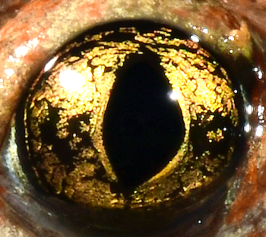
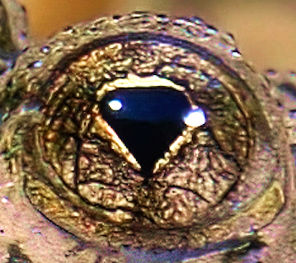
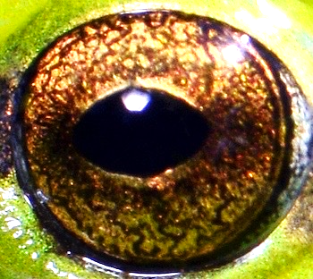
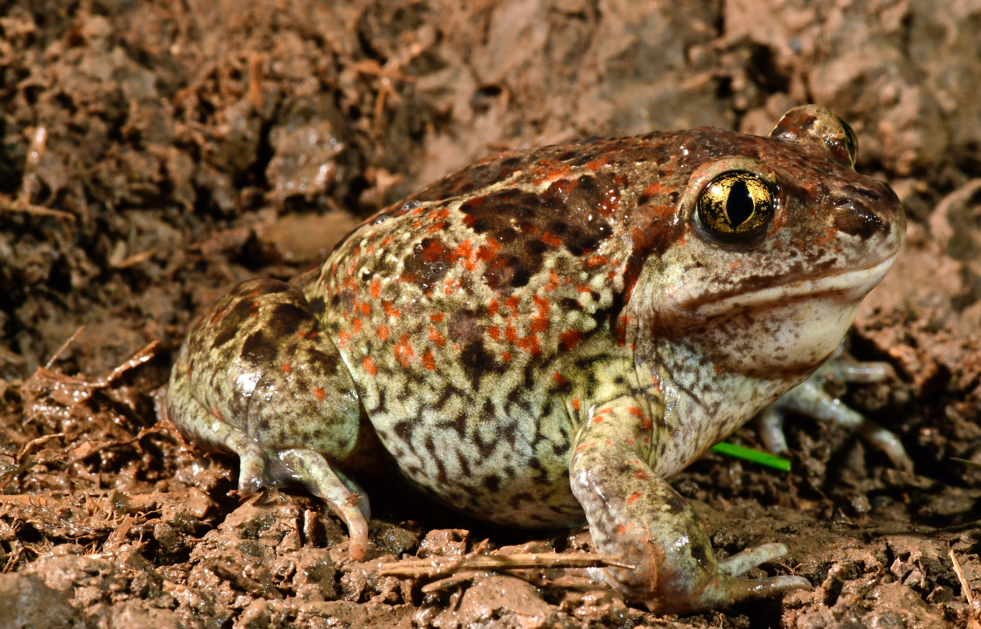
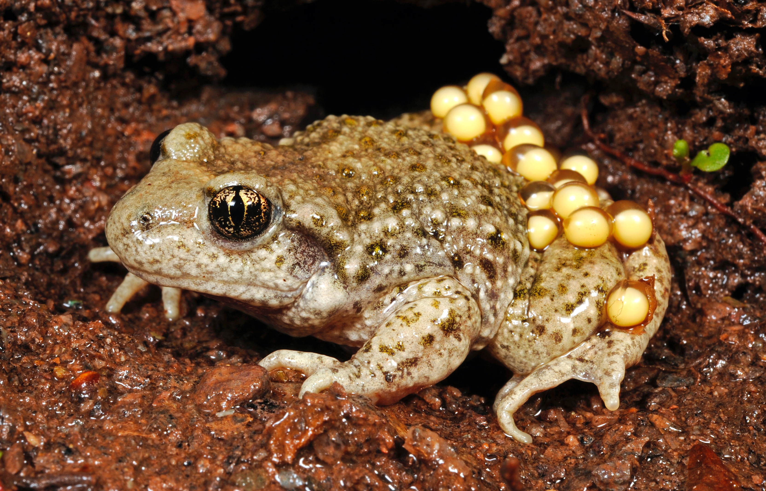
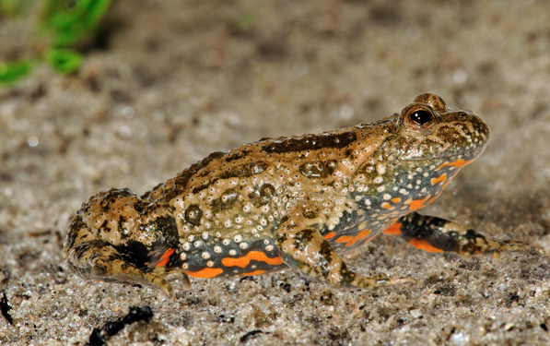
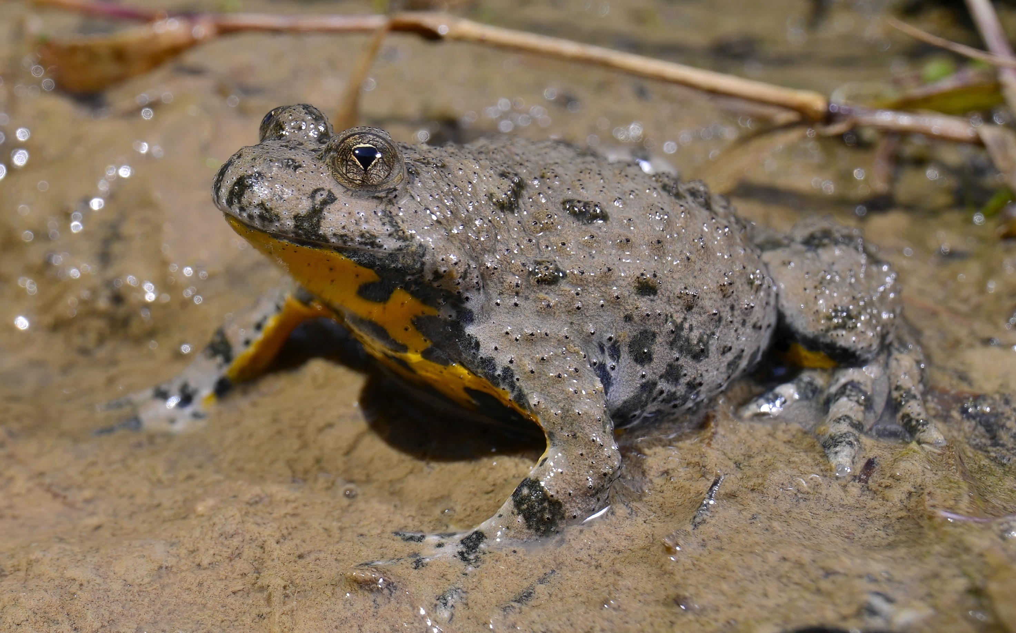
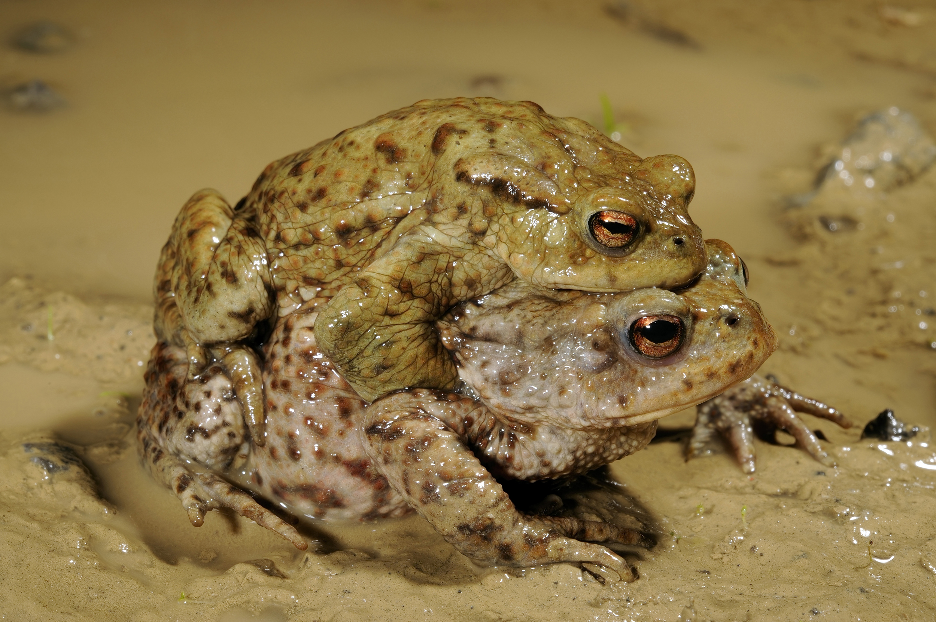
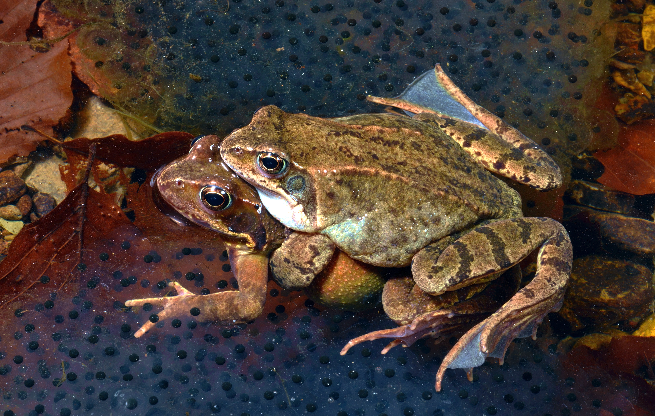
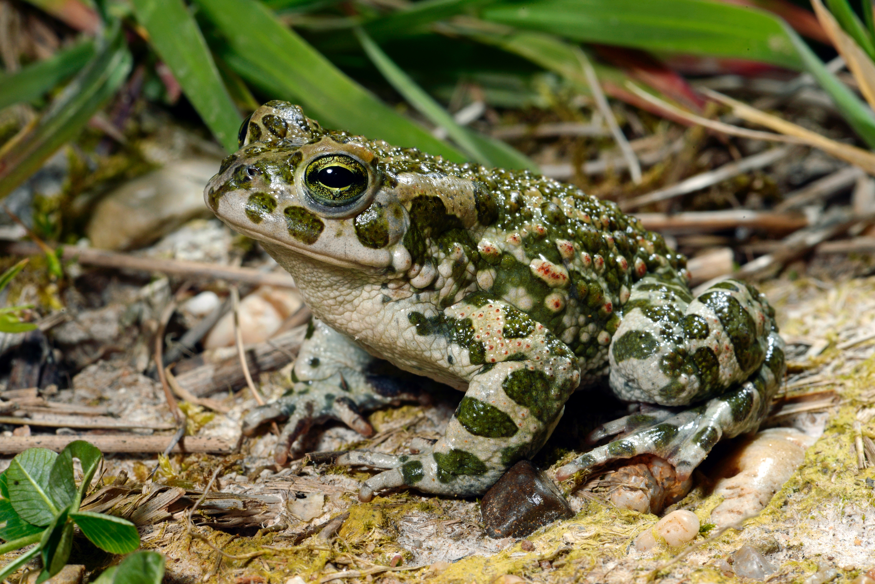
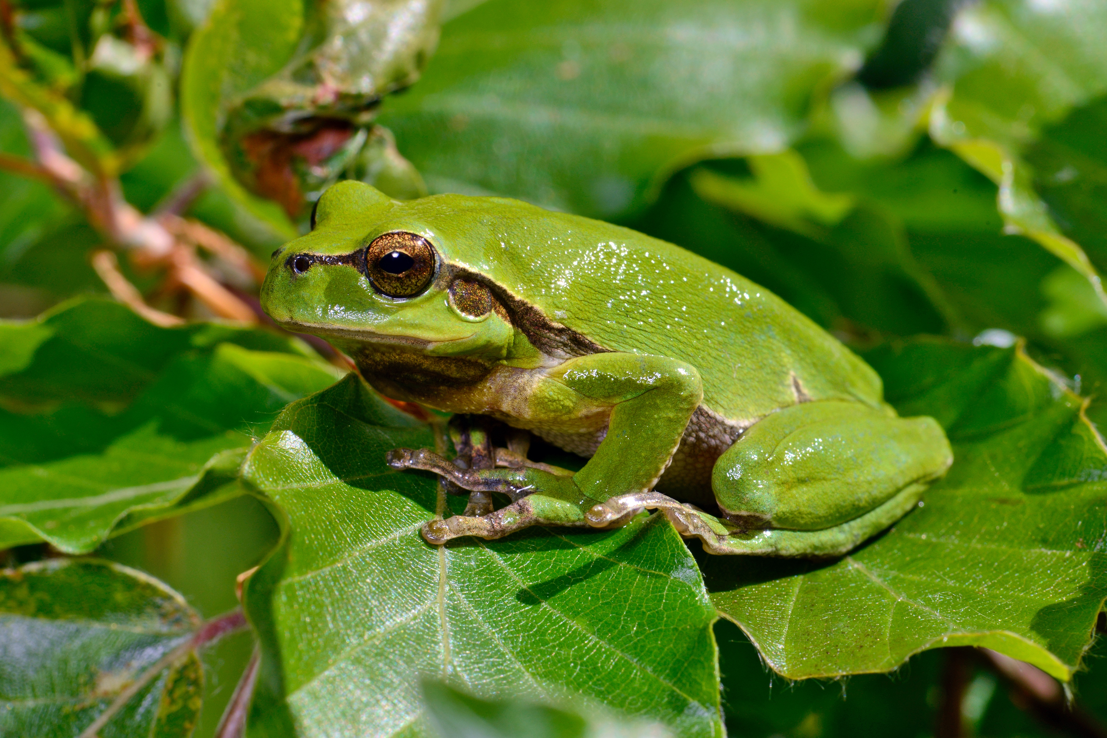
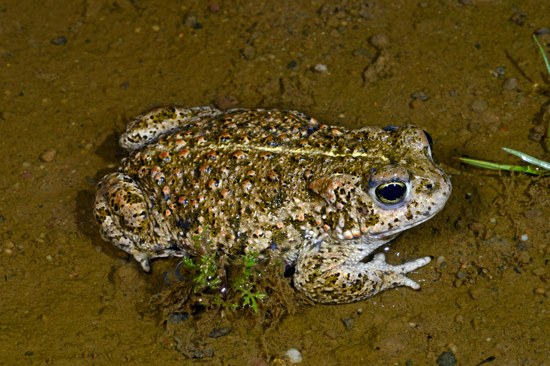
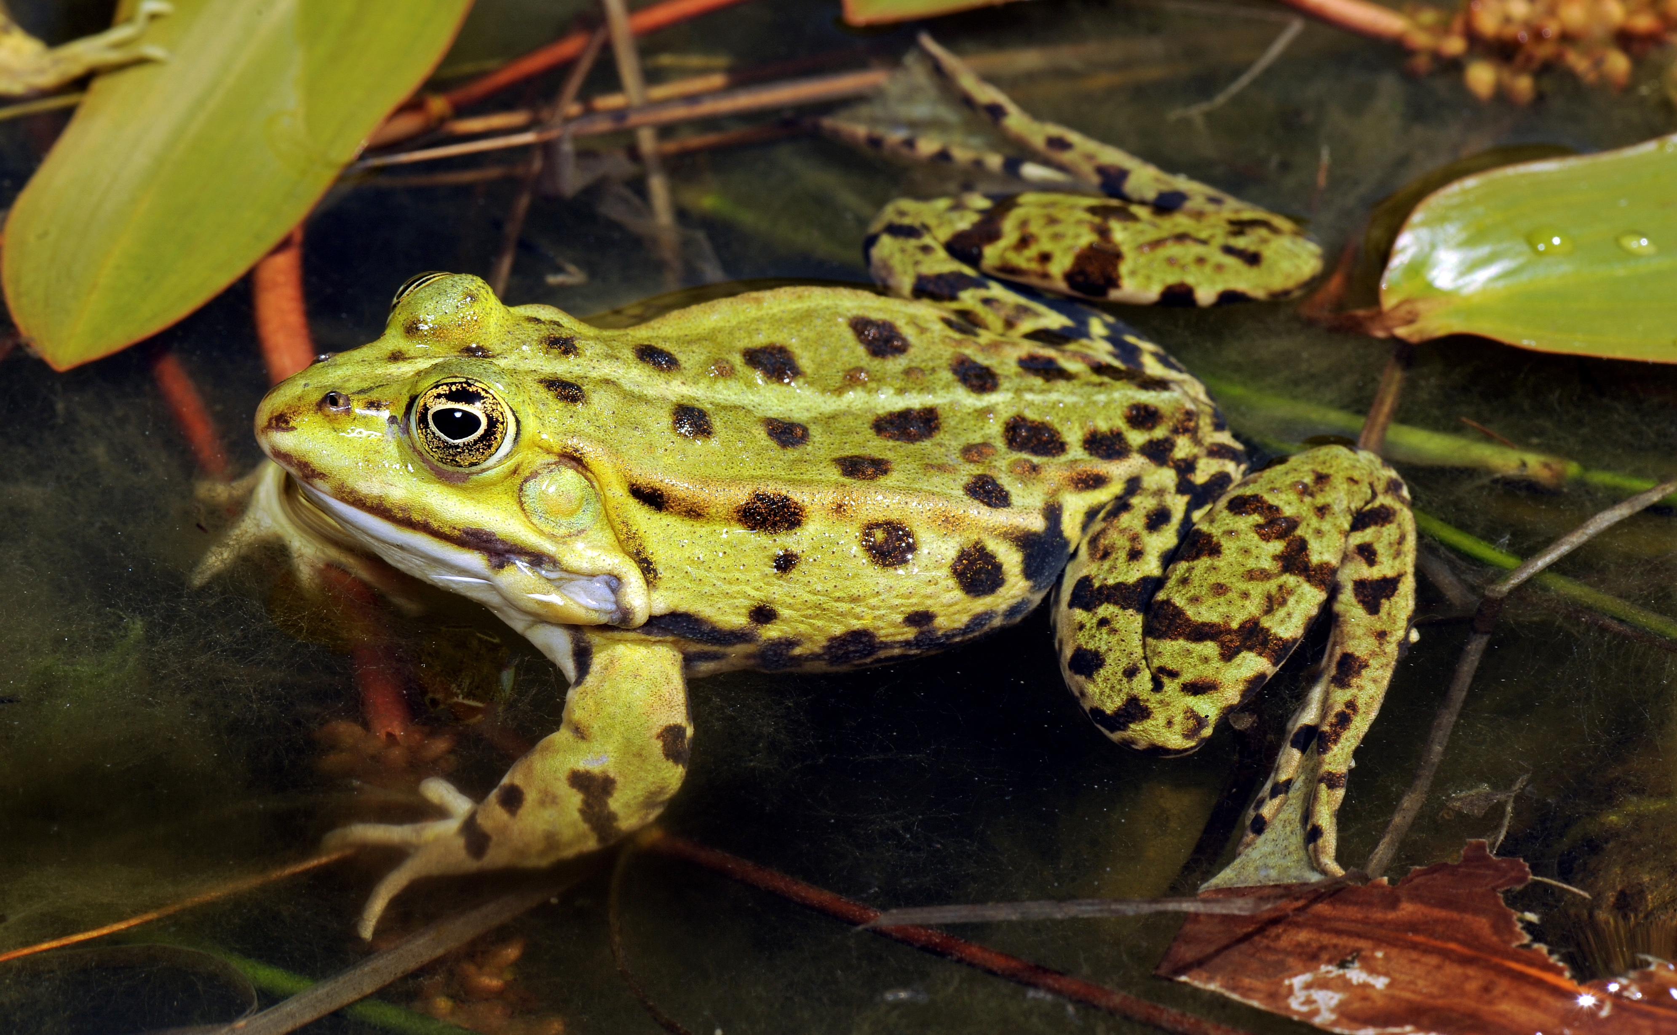
vertical pupils
Identification key for frogs and toads
heart shaped pupils
Look at the pupils first!
horizontal pupils
skin smooth
skin rough
belly color red
belly color yellow
Garlic toad - Knoblauchkröte
Midwife toad - Geburtshelferkröte
Fire-bellied toad - Rotbauchunke
Yellow-bellied toad - Gelbbauchunke
skin rough
skin smooth
skin mainly one color
skin color brown
skin more colors
skin color green
brown ear spot
big spots or patterns
skin plain green
small spots
skin spotted
Common toad - Erdkröte
yellow line down the back
Brown frogs* - Braunfrösche
Fotos © Benny Trapp
Green toad - Wechselkröte
Tree frog - Laubfrosch
Natterjack toad - Kreuzkröte
Green frogs* - Grünfrösche
* More than one species belong to the group brown frogs and green frogs

